Slide 1
Semesterproject Machine Learning II
Mikhail Stepanov
Computational Science (Master of Sc.)

Slide 2
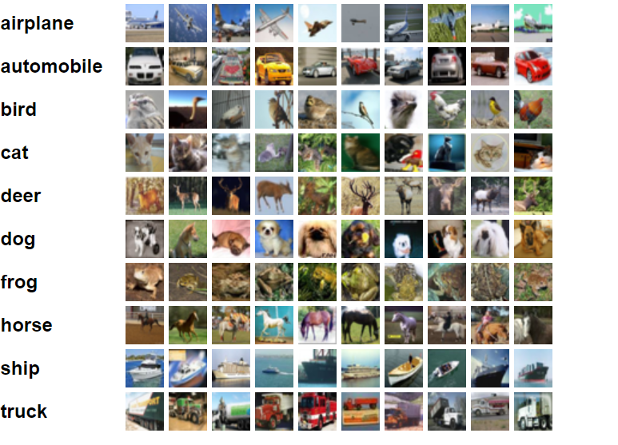
Image classification (Cifar-10)
In total 60.000 32x32 colour images
50.000 training images
10.000 test images
Test batch (1.000 randomly-selected images for each class)
Training batch (5.000 images from each class in random order)
https://www.cs.toronto.edu/~kriz/cifar.html

Slide 3
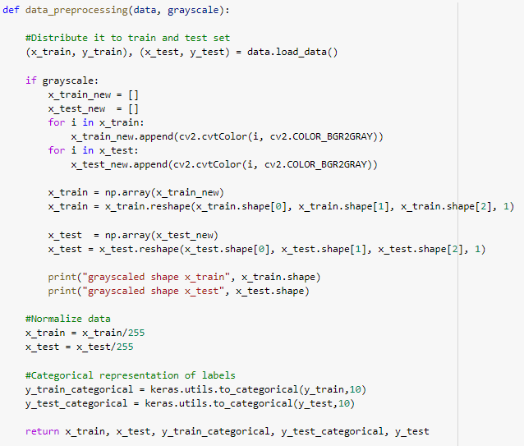
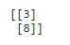
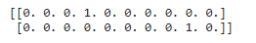
Load and preprocess data
- Load Cifar-10 dataset from keras
- Normalize x_train and x_test (devide by 255)
- Represent the labels in categorical form
By default
Categorical representation

Slide 4
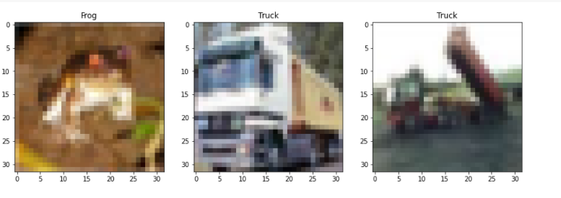
First 3 images in the dataset

Slide 5
First experiment with simple fully-connected NN

Slide 6
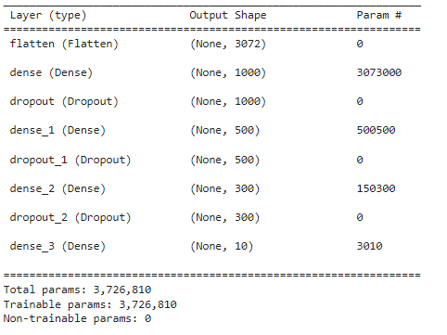
First experiment with simple fully-connected NN
Architecture
- 3 layers (1000, 500, 300 neurons)
- RELU activation function
≈37% accuracy on the test dataset after 30 epochs of training

Slide 7
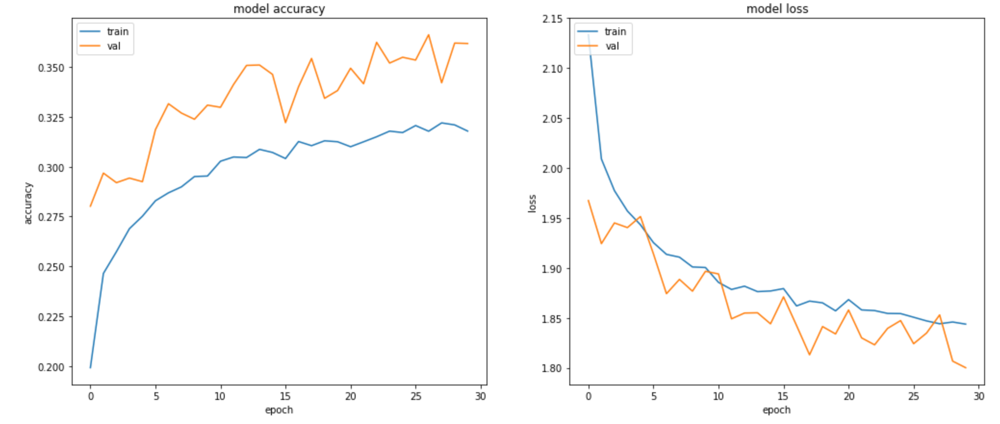
First experiment with simple fully-connected NN
Accuracy on the test dataset: ≈37%

Slide 8
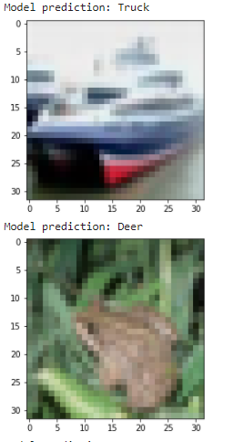
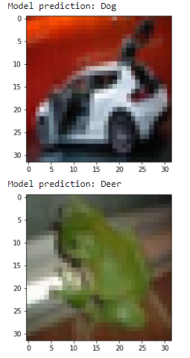
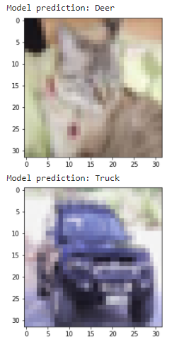
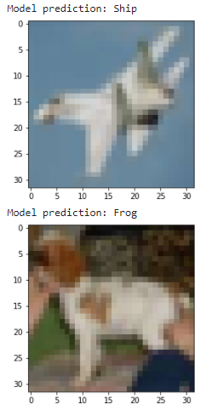
First experiment with simple fully-connected NN Some of the missclassified images

Slide 9
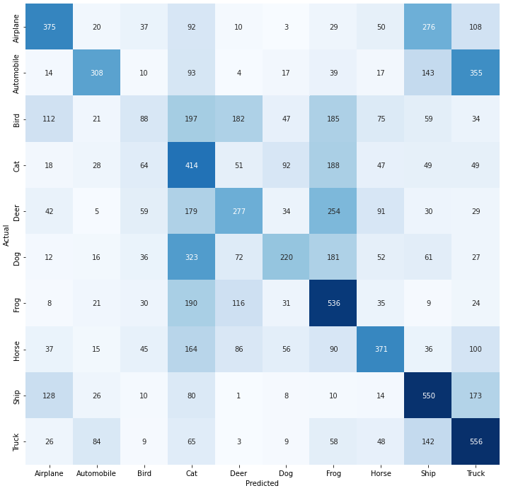
First experiment with simple fully-connected NN Confusion matrix

Slide 10
Principal component analysis

Slide 11
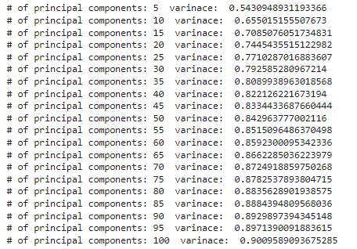
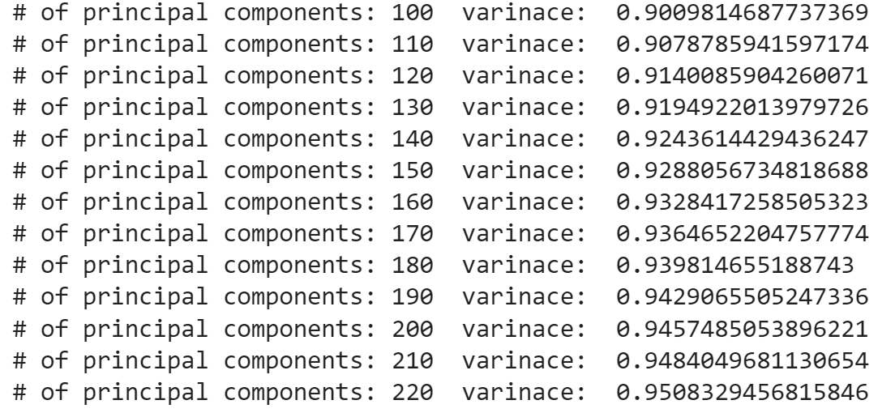
Principal component analysis

Slide 12
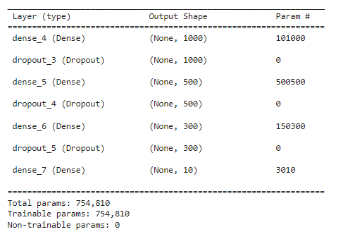
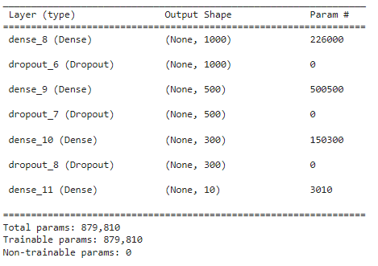
Experiments with fully-connected NN after applying of PCA
3 layers (1000, 500, 300 neurons), RELU, 90% of initial variance in the data (100 principal components)
3 layers (1000, 500, 300 neurons), RELU, 95% of initial variance in the data (225 principal components)

Slide 13
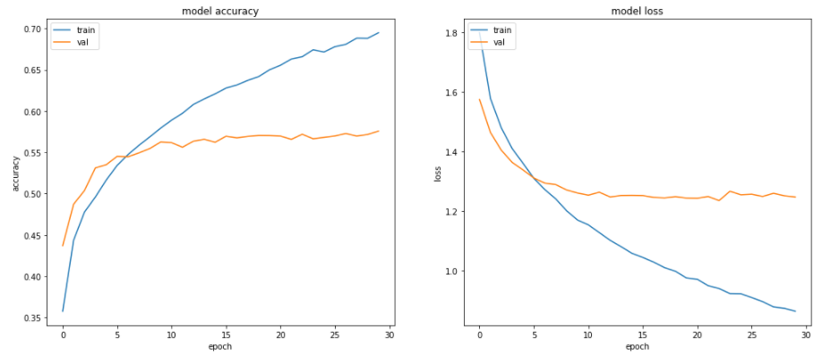
3 layers (1000, 500, 300 neurons), RELU, 90% of initial variance in the data (100 principal components)
Accuracy on the test dataset: ≈56,9%

Slide 14
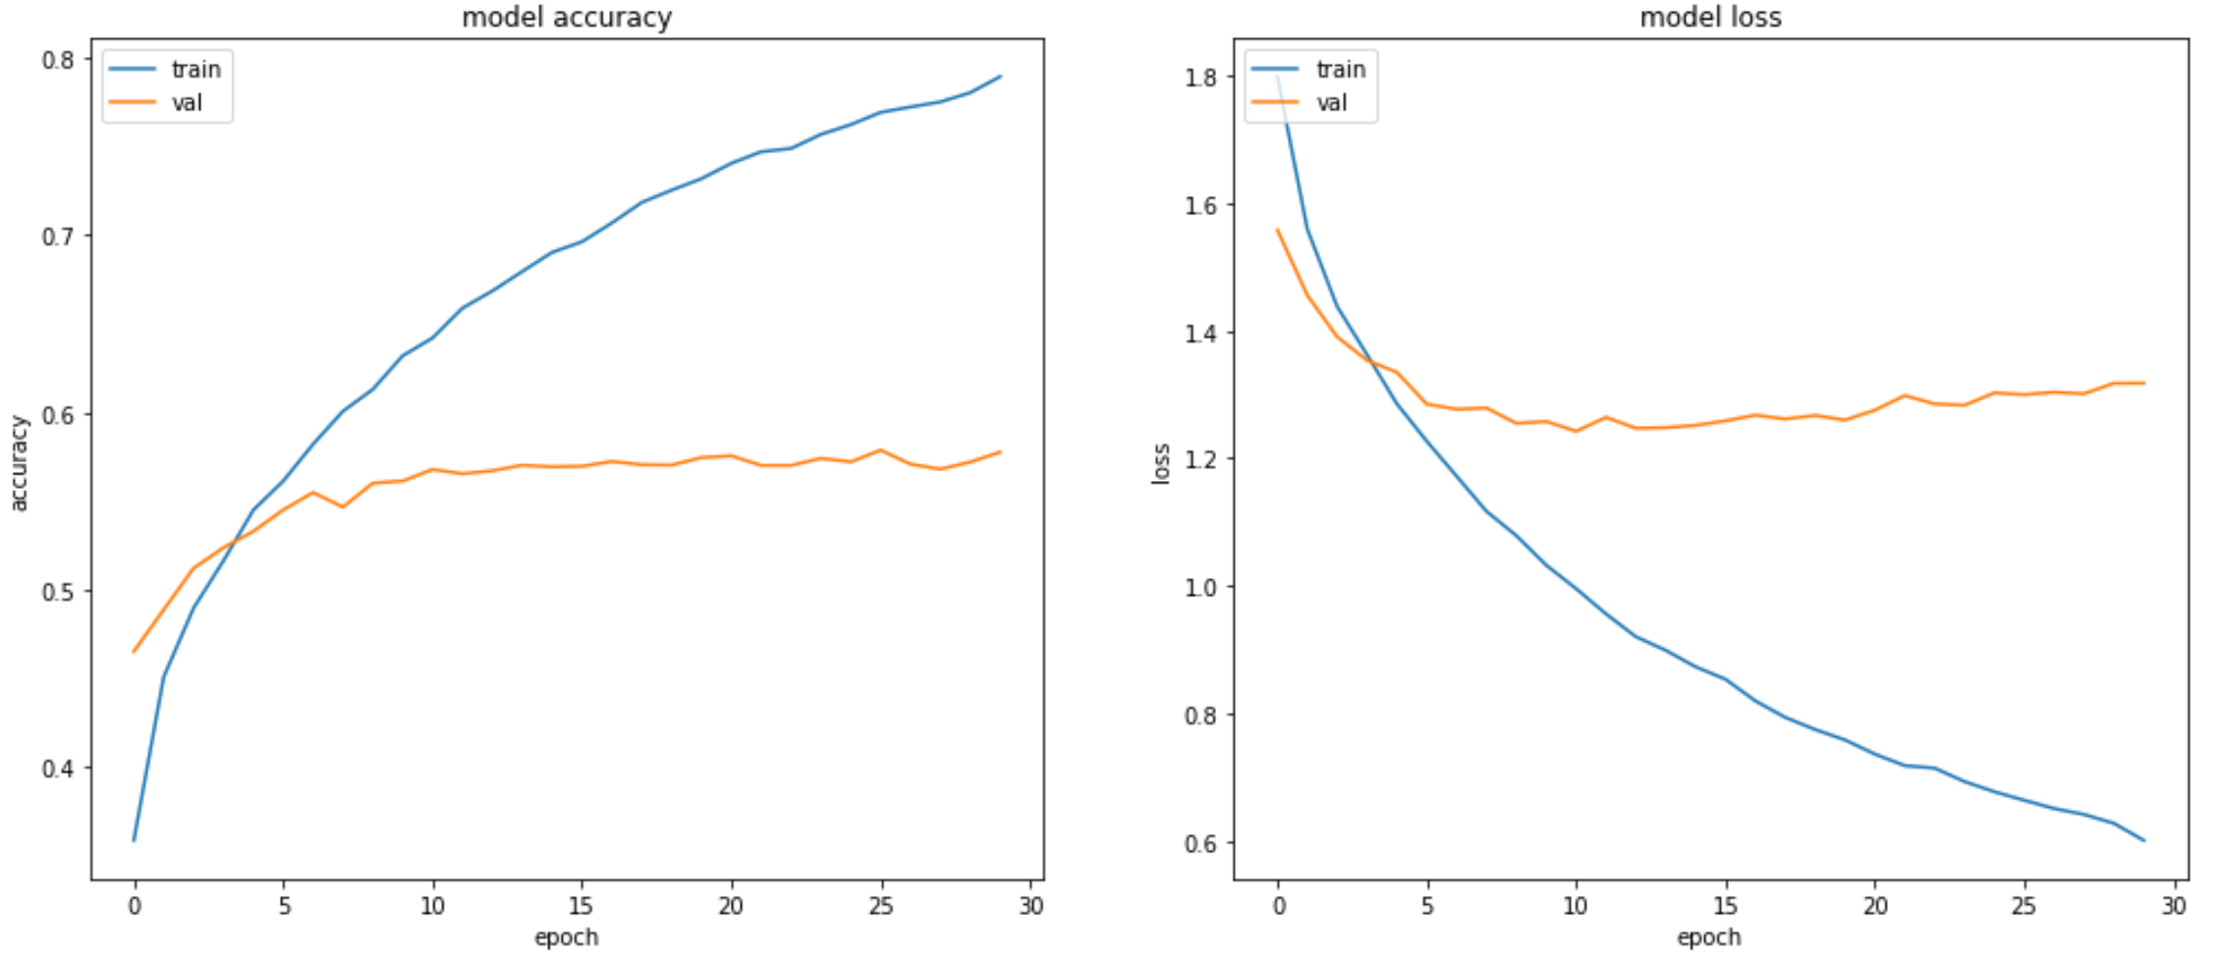
3 layers (1000, 500, 300 neurons), RELU, 95% of initial variance in the data (225 principal components)
Accuracy on the test dataset: ≈57,8%

Slide 15
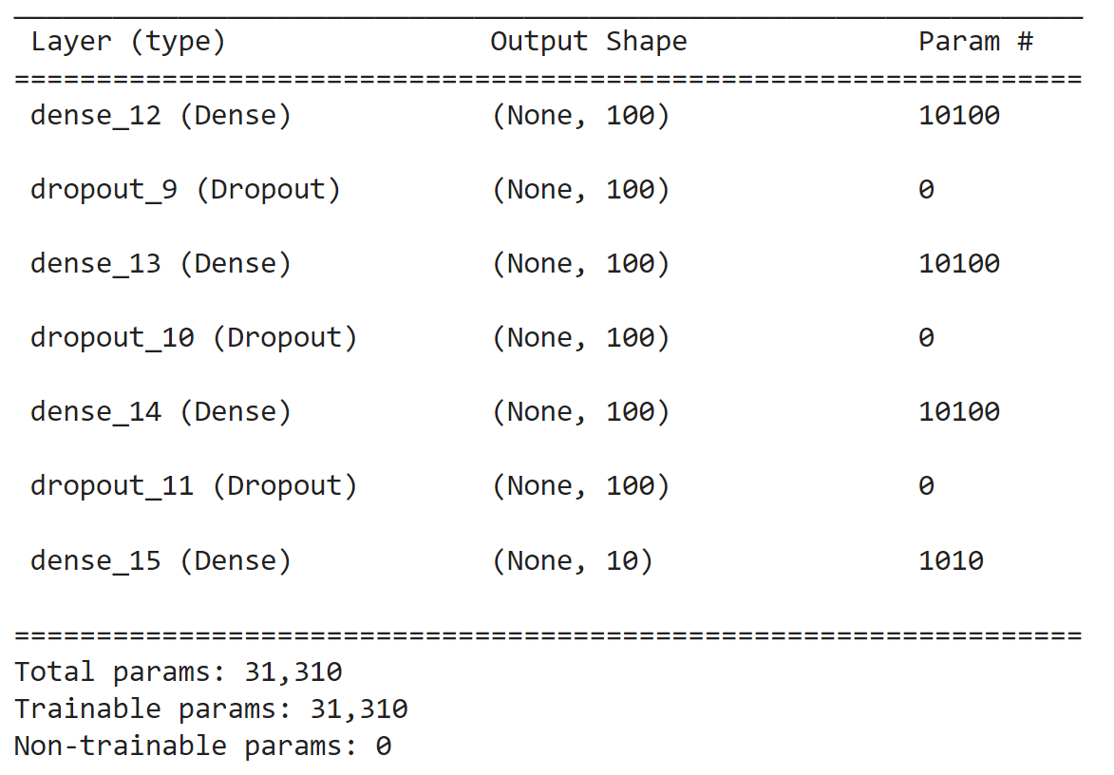
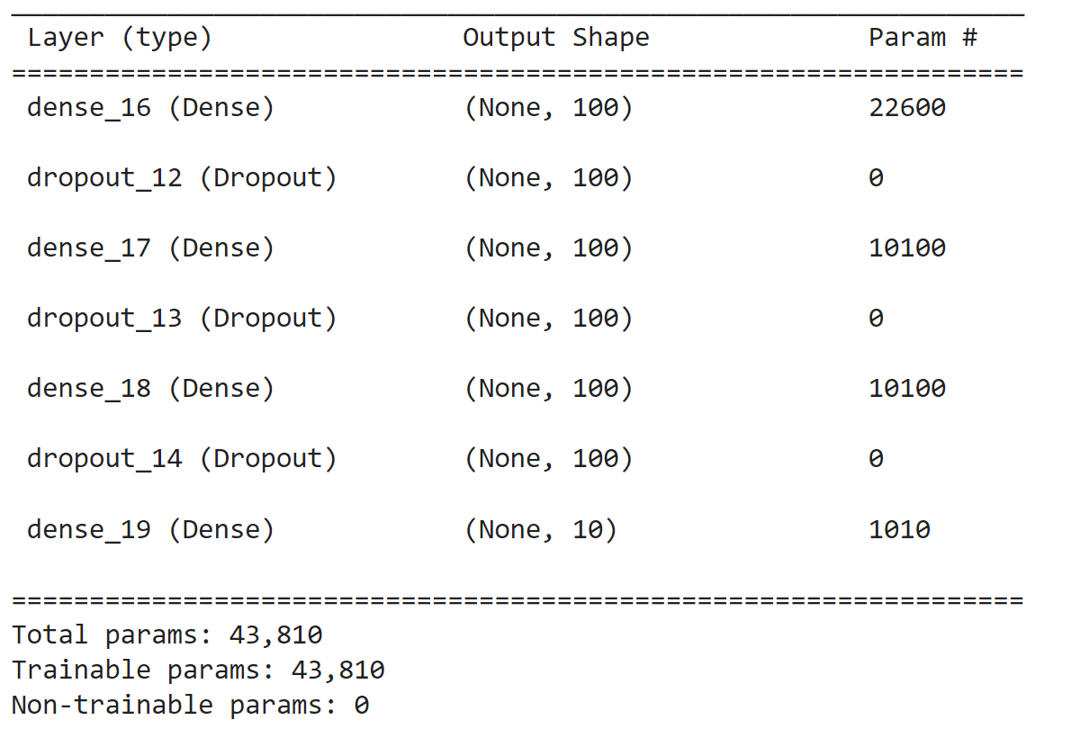
Experiments with fully-connected NN after applying of PCA
3 layers (100, 100, 100 neurons), RELU, 90% of initial variance in the data (100 principal components)
3 layers (100, 100, 100 neurons), RELU, 95% of initial variance in the data (225 principal components)

Slide 16
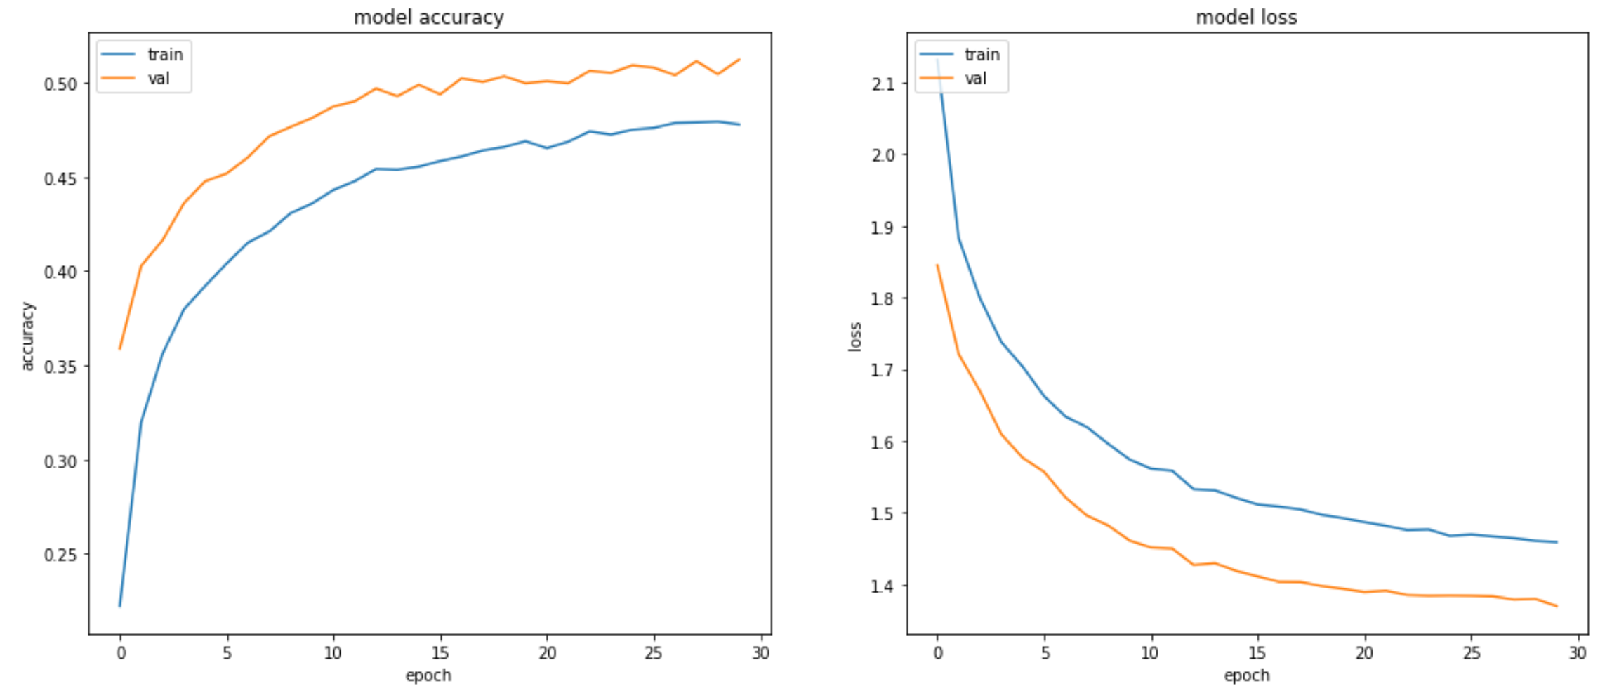
3 layers (100, 100, 100 neurons), RELU, 90% of initial variance in the data (100 principal components)
Accuracy on the test dataset: ≈51,2%

Slide 17
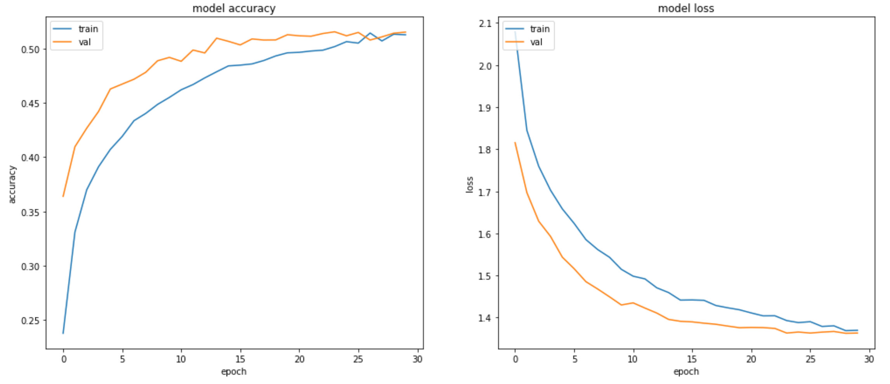
3 layers (100, 100, 100 neurons), RELU, 95% of initial variance in the data (225 principal components)
Accuracy on the test dataset: ≈51,9%

Slide 18

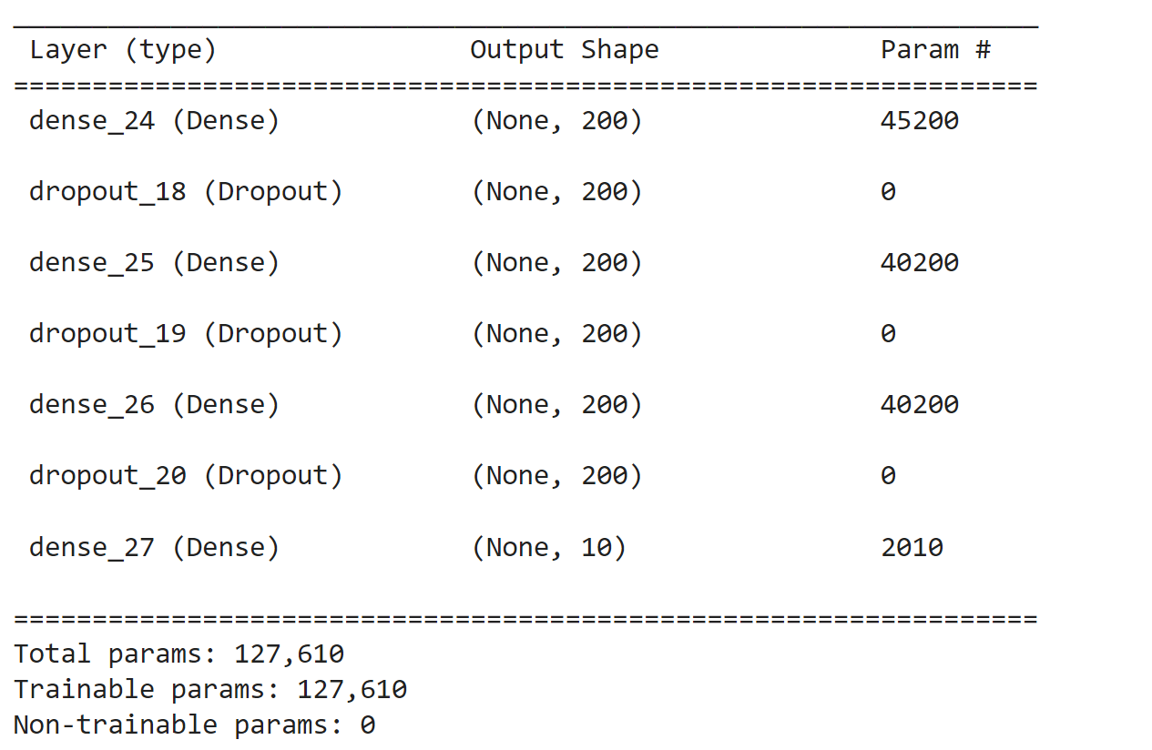
Experiments with fully-connected NN after applying of PCA
3 layers (200, 200, 200 neurons), RELU, 90% of initial variance in the data (100 principal components)
3 layers (200, 200, 200 neurons), RELU, 95% of initial variance in the data (225 principal components)

Slide 19
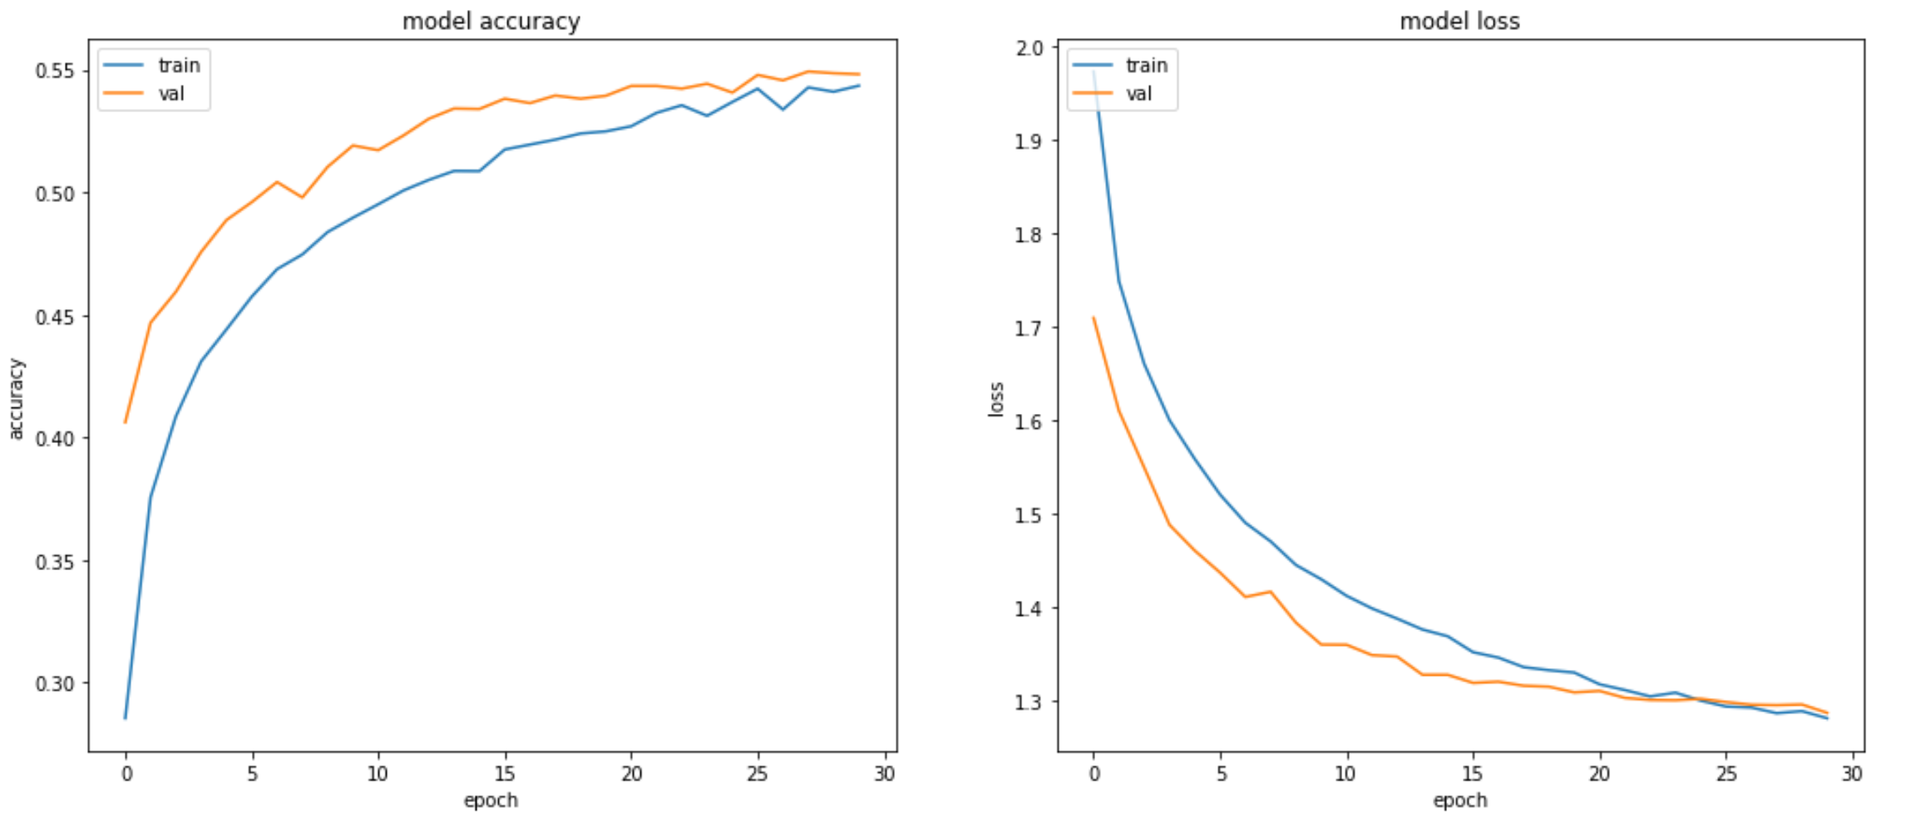
3 layers (200, 200, 200 neurons), RELU, 90% of initial variance in the data (100 principal components)
Accuracy on the test dataset: ≈54,1%

Slide 20
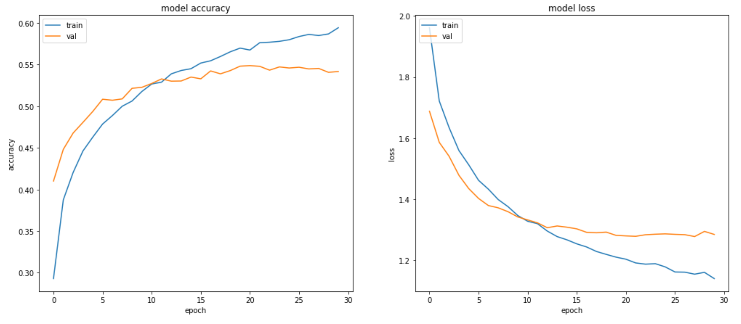
3 layers (200, 200, 200 neurons), RELU, 95% of initial variance in the data (225 principal components)
Accuracy on the test dataset: ≈53,9%

Slide 21
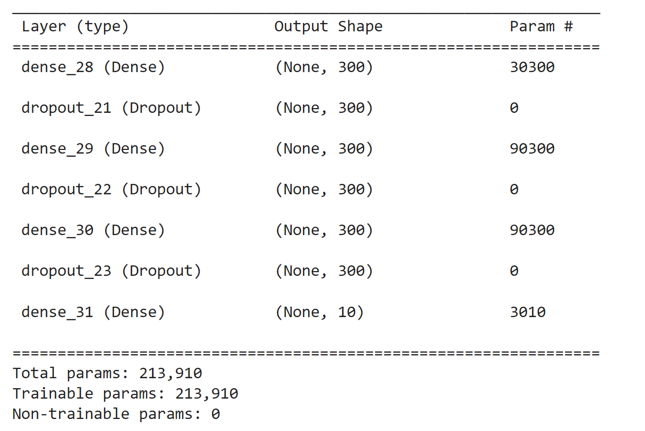
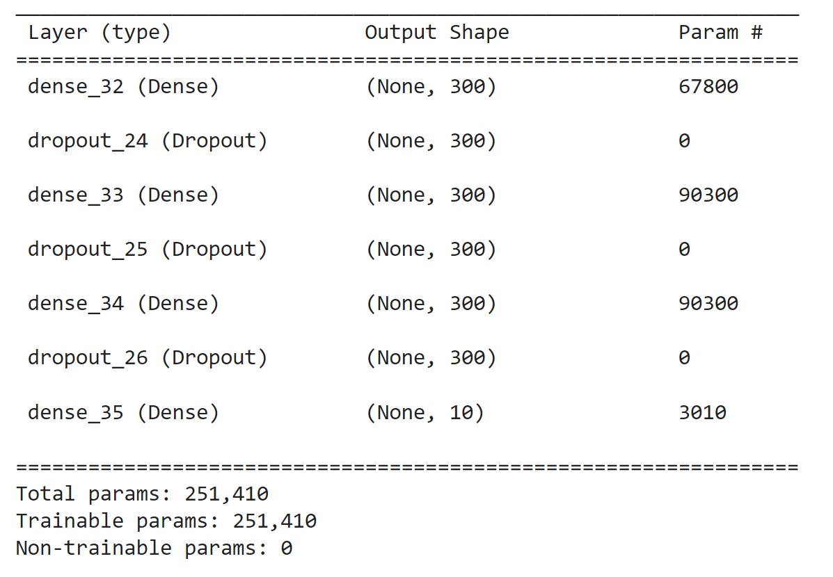
Experiments with fully-connected NN after applying of PCA
3 layers (300, 300, 300 neurons), RELU, 90% of initial variance in the data (100 principal components)
3 layers (300, 300, 300 neurons), RELU, 95% of initial variance in the data (225 principal components)

Slide 22
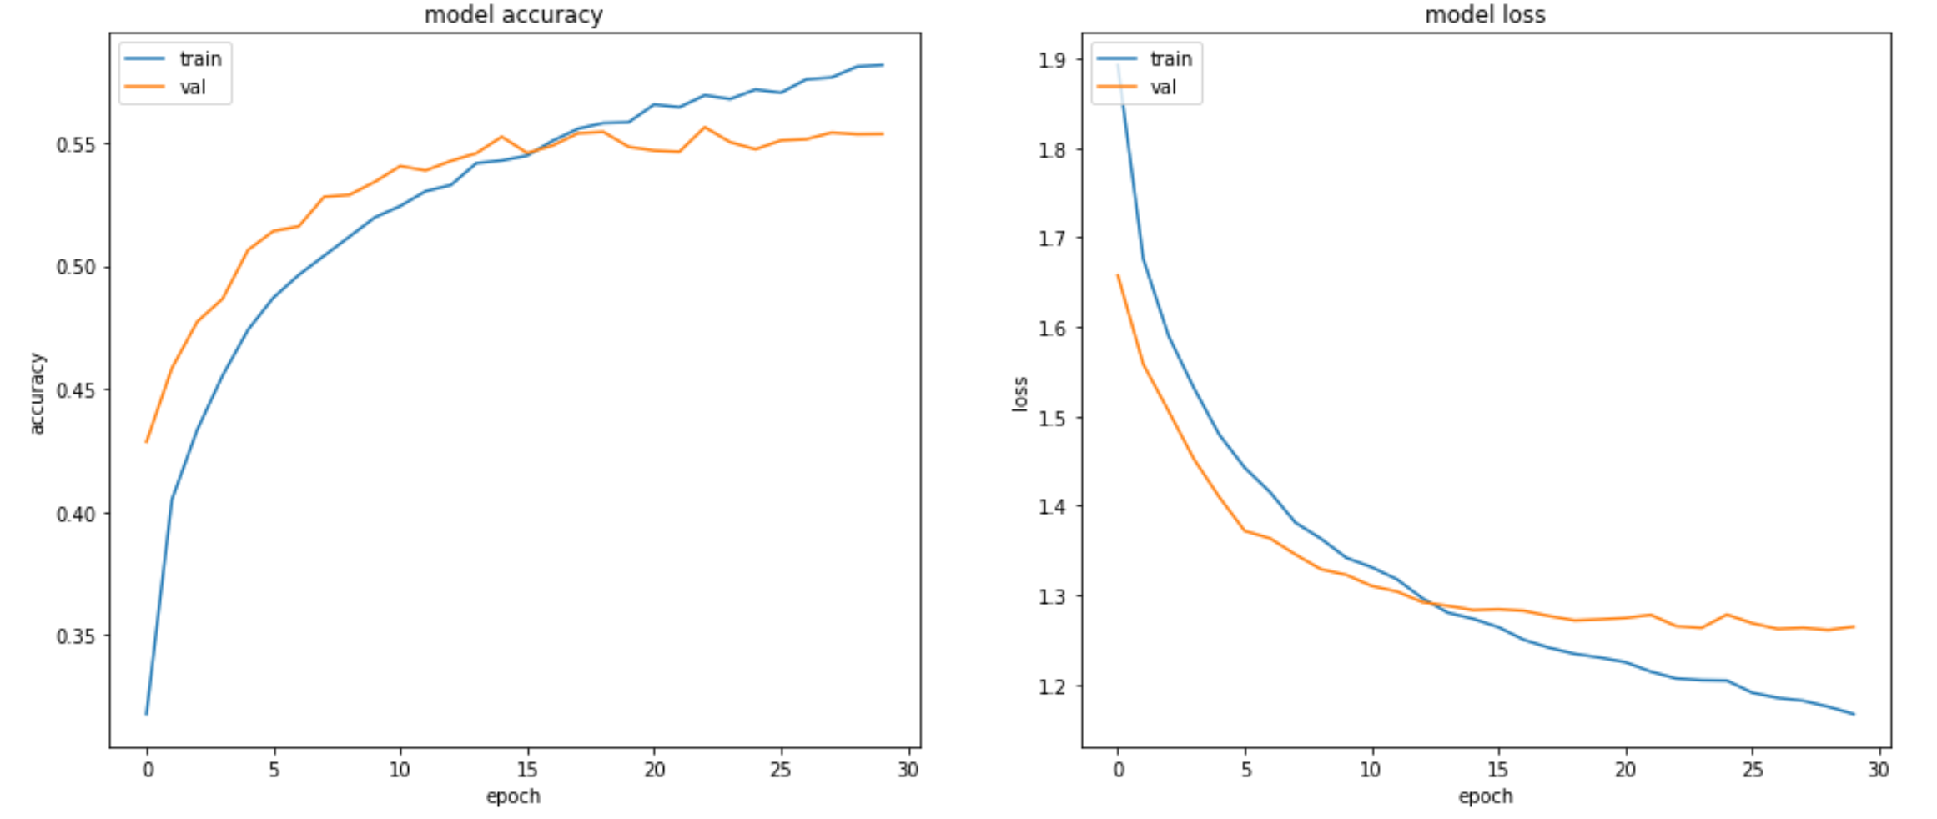
3 layers (300, 300, 300 neurons), RELU, 90% of initial variance in the data (100 principal components)
Accuracy on the test dataset: ≈55,1%

Slide 23
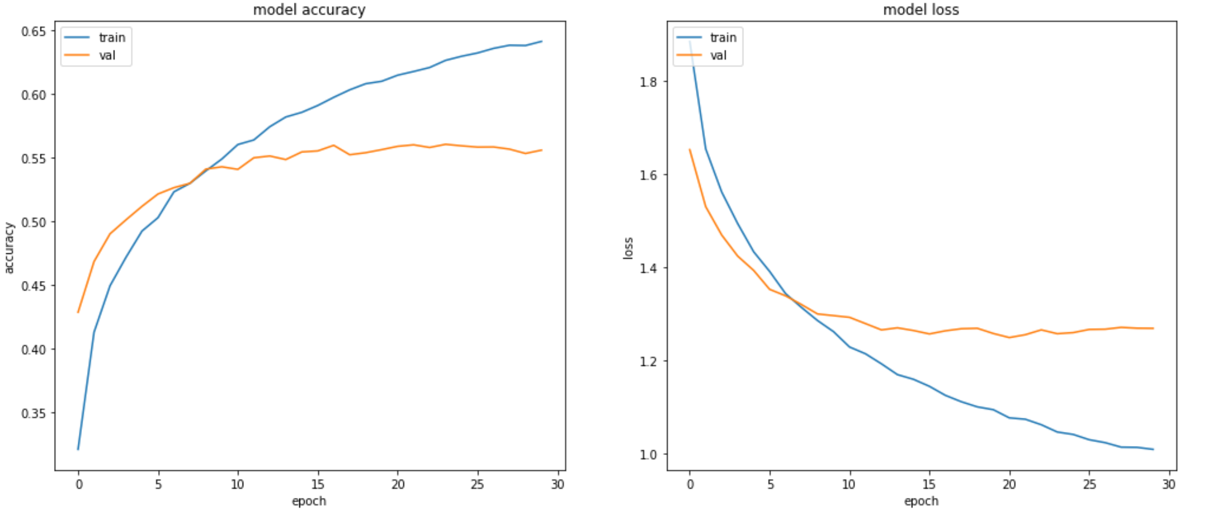
3 layers (300, 300, 300 neurons), RELU, 95% of initial variance in the data (225 principal components)
Accuracy on the test dataset: ≈54,7%

Slide 24
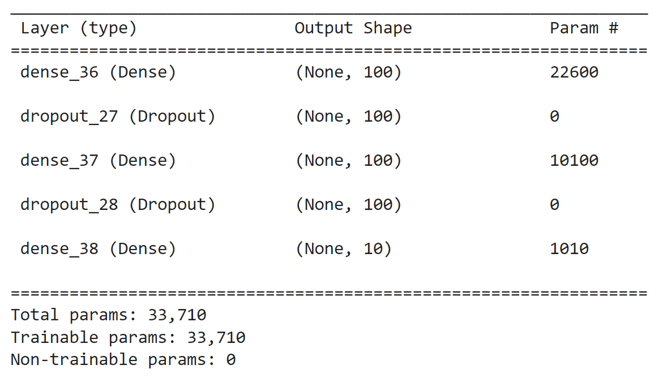
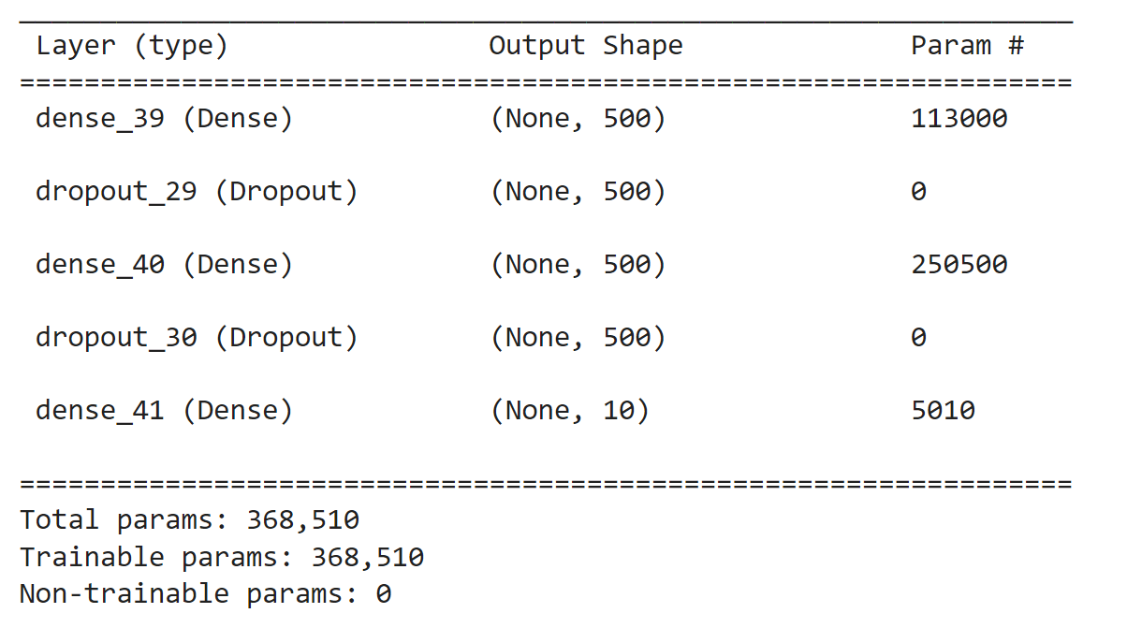
Experiments with fully-connected NN after applying of PCA
2 layers (100, 100 neurons), RELU, 95% of initial variance in the data (225 principal components)
2 layers (500, 500 neurons), RELU, 95% of initial variance in the data (225 principal components)

Slide 25
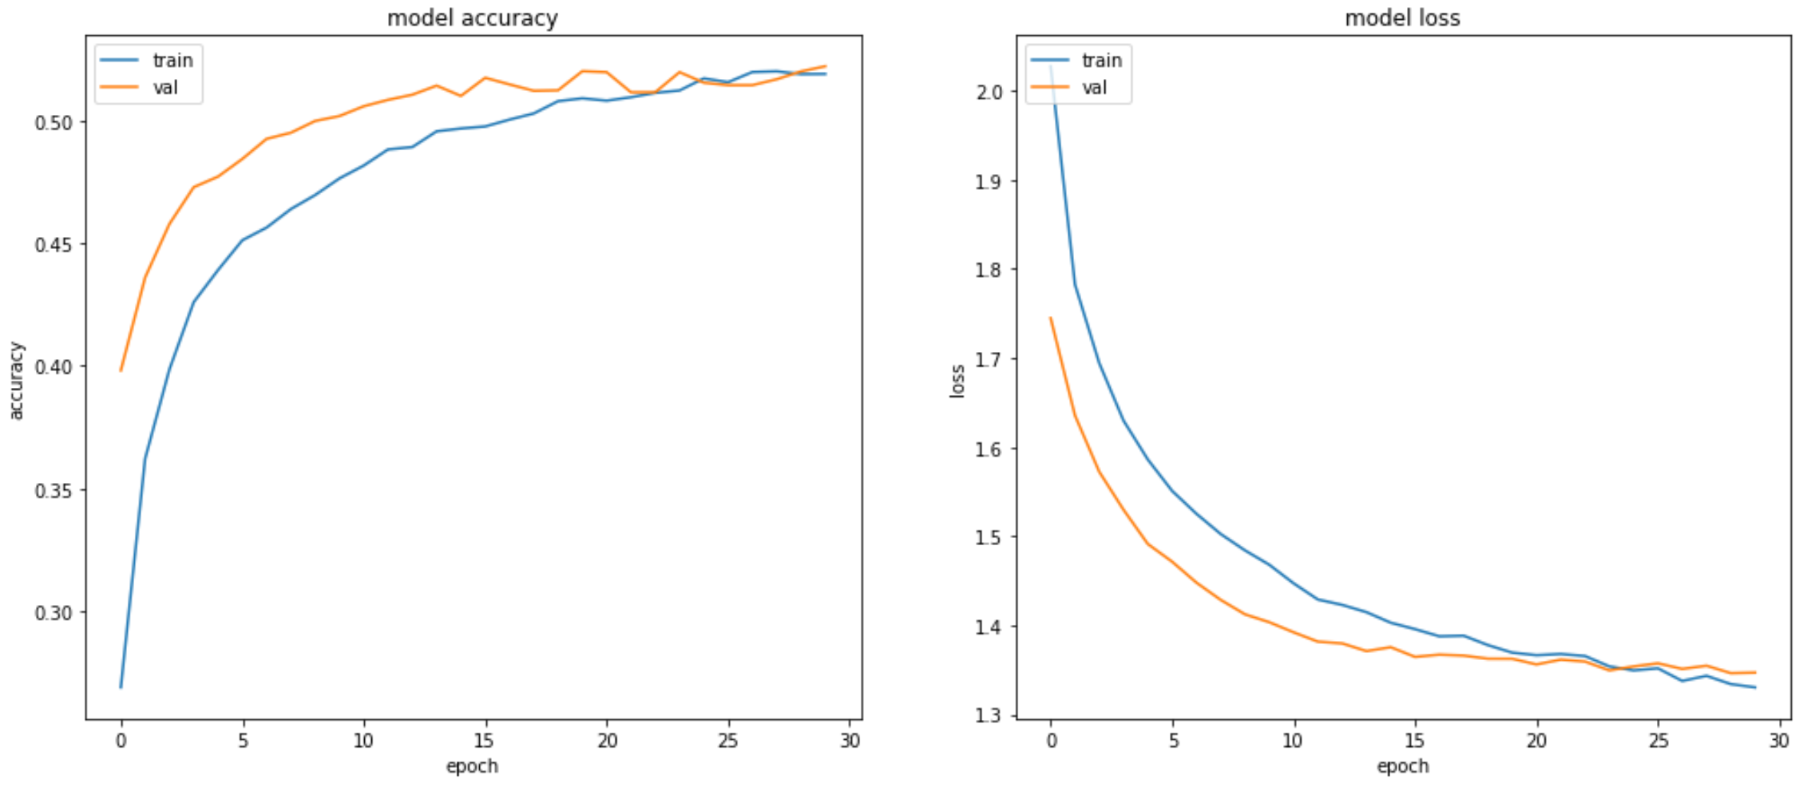
3 layers (100, 100 neurons), RELU, 95% of initial variance in the data (100 principal components)
Accuracy on the test dataset: ≈51,8%

Slide 26
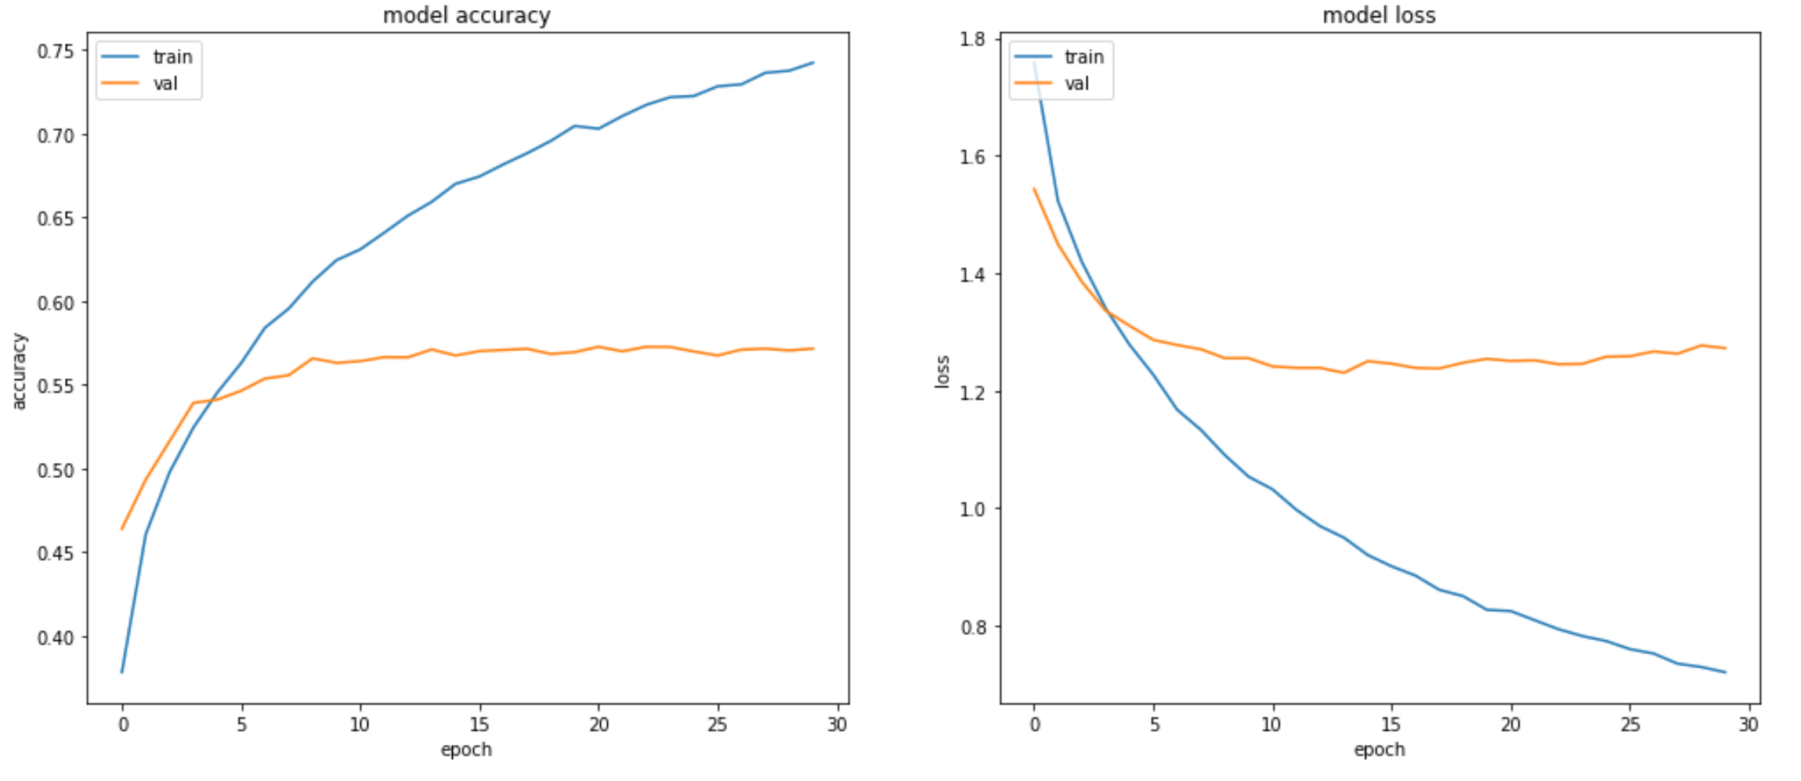
3 layers (500, 500 neurons), RELU, 95% of initial variance in the data (225 principal components)
Accuracy on the test dataset: ≈57%

Slide 27
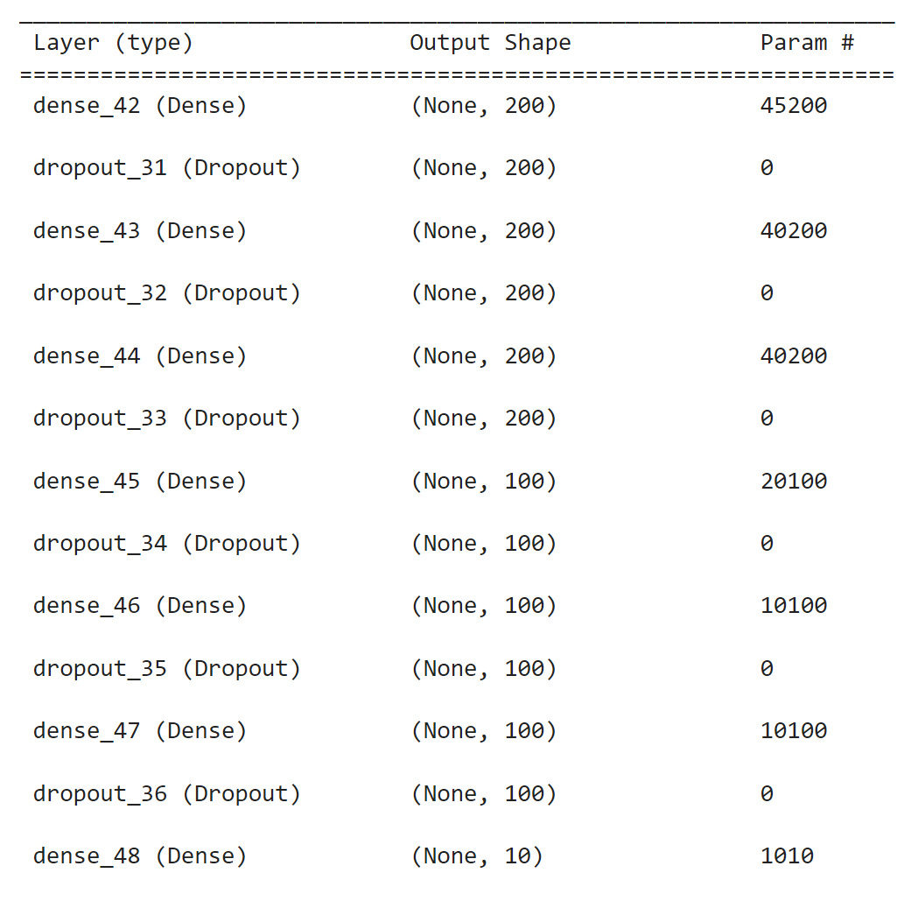
Experiments with fully-connected NN after applying of PCA
6 layers (200, 200, 200, 100, 100, 100 neurons), RELU, 95% of initial variance in the data (225 principal components)

Slide 28
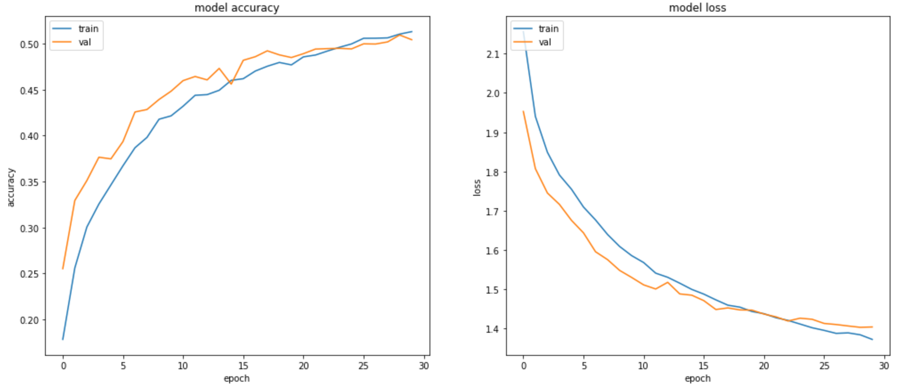
6 layers (200, 200, 200, 100, 100, 100 neurons), RELU, 95% of initial variance in the data (225 principal components)
Accuracy on the test dataset: ≈49,9%

Slide 29
Experiments with convolutional NN

Slide 30
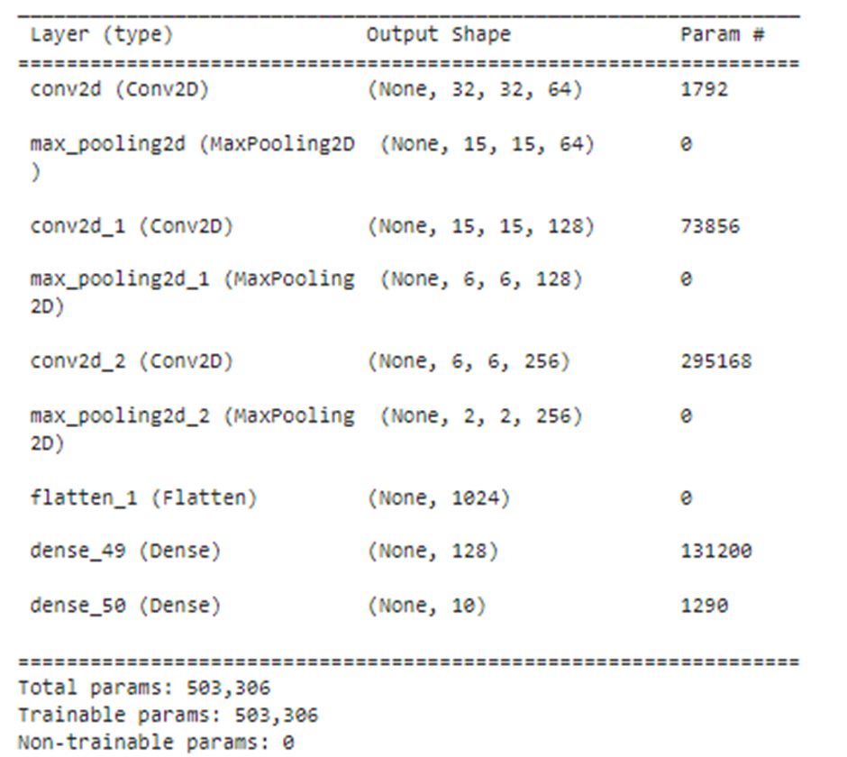
Experiments with CNN CNN architecture with 1 fully-connected layer on the head without dropout
3 convolutional layers (kernel size = 3x3, stride = 1, padding = 1, activation function Leaky ReLU, max pooling layer after each conv. layer with 4x4 kernel and stride=2), 1 fully-connected layer (128 neurons)
1st layer – 64 filters
2nd layer – 128 filters
3rd layer – 256 filters

Slide 31
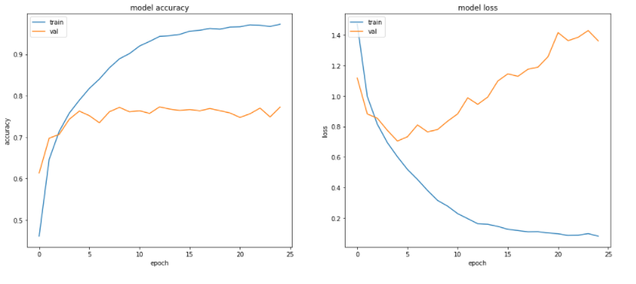
3 convolutional layers, 1 fully-connected layer, without dropout
Accuracy on the test dataset: ≈77%

Slide 32
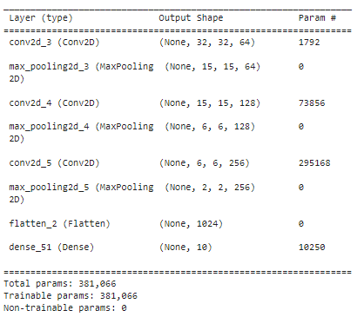
Experiments with CNN CNN architecture without FCNN on the head without dropout
3 convolutional layers (kernel size = 3x3, stride = 1, padding = 1, activation function Leaky ReLU, max pooling layer after each conv. layer with 4x4 kernel and stride=2), 1st layer – 64 filters
2nd layer – 128 filters
3rd layer – 256 filters

Slide 33
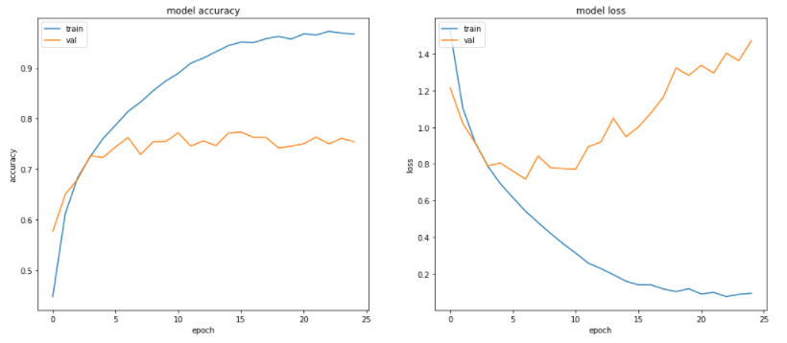
3 convolutional layers, without FC layers, without dropout
Accuracy on the test dataset: ≈73,8%

Slide 34
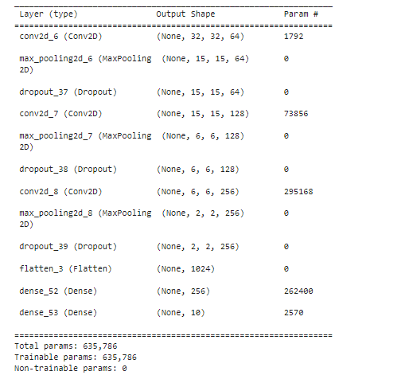
Experiments with CNN CNN architecture with 1 fully-connected layer on the head with dropout
3 convolutional layers (kernel size = 3x3, stride = 1, padding = 1, activation function Leaky ReLU, max pooling layer after each conv. layer with 4x4 kernel and stride=2), 1 fully-connected layer (256 neurons)
1st layer – 64 filters
2nd layer – 128 filters
3rd layer – 256 filters

Slide 35
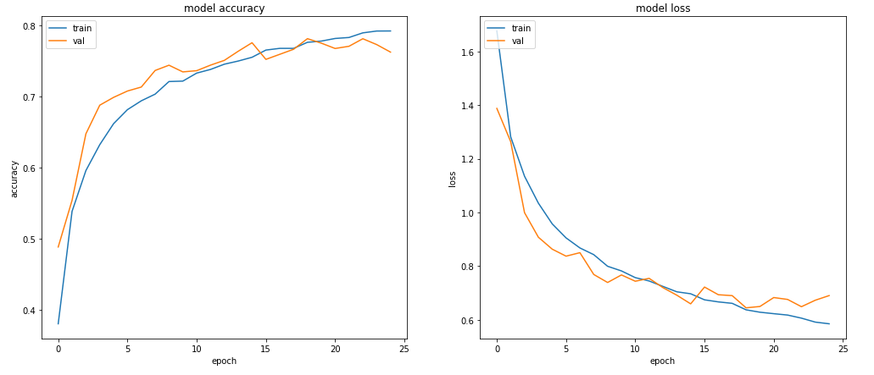
3 convolutional layers, 1 fully-connected layer (256 neurons), with dropout
Accuracy on the test dataset: ≈76,2%

Slide 36
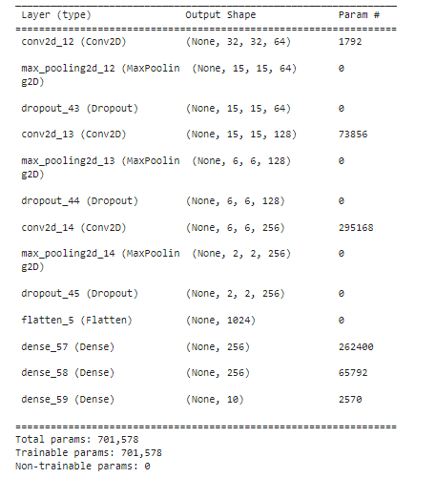
Experiments with CNN CNN architecture with 2 fully-connected layers on the head with dropout
3 convolutional layers (kernel size = 3x3, stride = 1, padding = 1, activation function Leaky ReLU, max pooling layer after each conv. layer with 4x4 kernel and stride=2), 2 fully-connected layer (256 neurons each)
1st layer – 64 filters
2nd layer – 128 filters
3rd layer – 256 filters

Slide 37
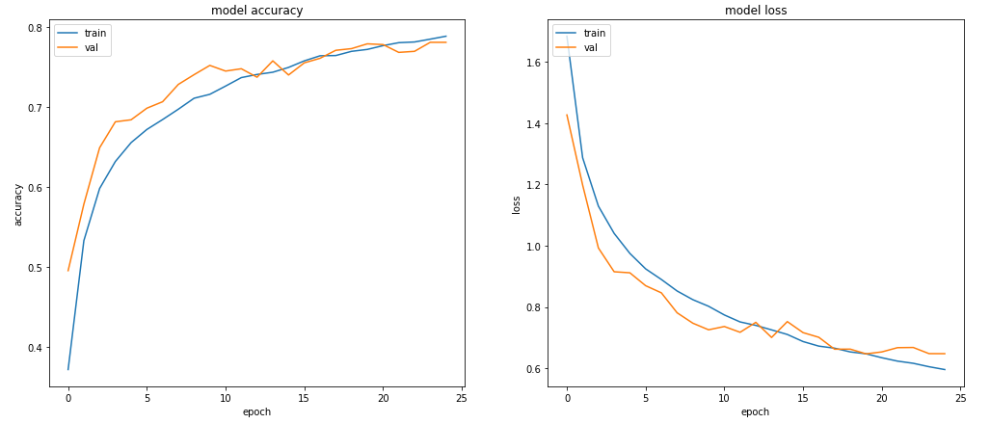
3 convolutional layers, 2 fully-connected layers (256 neurons), with dropout
Accuracy on the test dataset: ≈77,5%

Slide 38
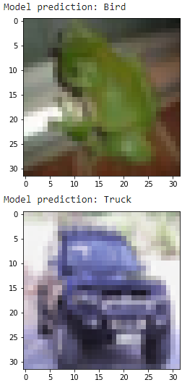
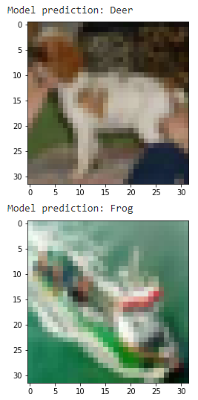
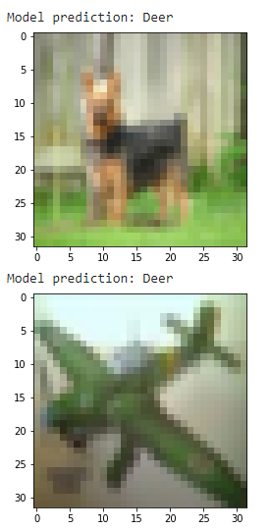
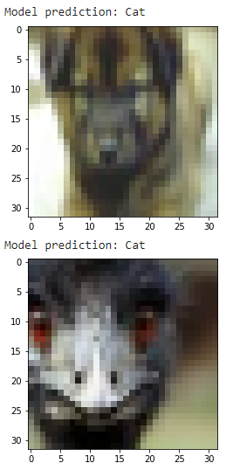
Experiments with CNN. 3 conv. Layers + 2 fully-connected layers on the head with dropout Some of the missclassified images

Slide 39
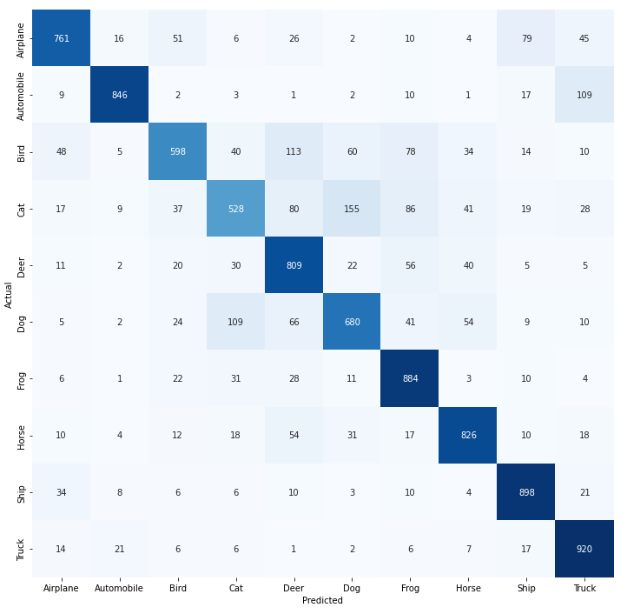
Experiments with CNN. 3 conv. Layers + 2 fully-connected layers on the head with dropout Confusion matrix

Slide 40
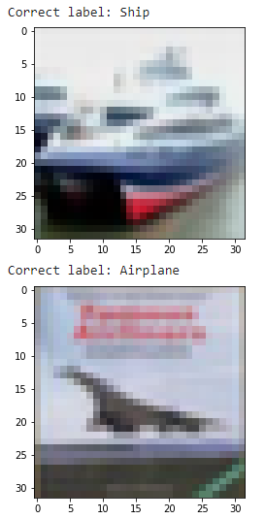
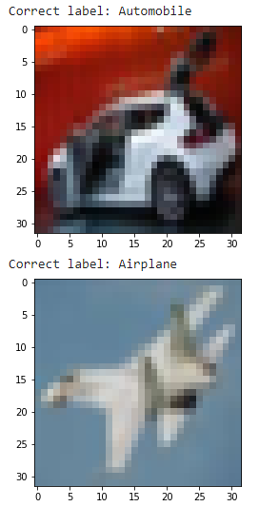


Comparision of FCNN and best CNN model. Some pitctures (missclassified by FCNN, but correctely classified by CNN architecture)

Slide 41
Experiments with gray-scaled data

Slide 42

Experiments with gray-scaled images

Slide 43

Experiments with fully-connected NN after applying of PCA on gray-scaled data
3 layers (300, 300, 300 neurons), RELU, 95% of initial variance in the data (165 principal components)

Slide 44

Fully-connected NN after applying of PCA on grayscaled data
Accuracy on the test dataset: ≈48%

Slide 45

Experiments with CNN CNN architecture with 2 fully-connected layers on the head with dropout on gray-scaled images
3 convolutional layers (kernel size = 3x3, stride = 1, padding = 1, activation function Leaky ReLU, max pooling layers after each conv. layer with 4x4 kernel and stride=2), 2 fully-connected layer (256 neurons each)
1st layer – 64 filters
2nd layer – 128 filters
3rd layer – 256 filters

Slide 46

3 convolutional layers, 2 fully-connected layers (256 neurons), with dropout
Accuracy on the test dataset: ≈74,9%

Slide 47




Experiments with CNN. 3 conv. Layers + 2 fully-connected layers on the head with dropout (gray-scaled images) Some of the missclassified images

Slide 48

Experiments with CNN. 3 conv. Layers + 2 fully-connected layers on the head with dropout (gray-scaled images) Confusion matrix

Slide 49
Comparision of classifcation results

Slide 50
Fully-connected NN (without PCA)
Best CNN (on the colour images)
Best CNN (on the gray-scaled images)

Slide 51
Appendix

Slide 52


Slide 53


Slide 54



Slide 55

Backpropagation Through Time (BPTT)
Remember, the purpose of recurrent nets is to accurately classify sequential input. We rely on the backpropagation of error and gradient descent to do so.

